Slide 1

University Of Dayton Natural Language Processing
Project Presentation Part-1
Analyzing User Feedback for Error Detection
By : Sandeep Sangvi
Aravind Morigadi

Slide 2

This project simplifies how developers handle user feedback by using NLP technique. Our goal is to speed up error detection and resolution, helping developers fix problems faster and more effectively which speeds up error detection and resolution, improving app quality and user satisfaction.
Project
Introduction

Slide 3

The Problem
1
Data Overload
2
Slow Resolution
3
Disorganized Feedback
Large amounts of user feedbacks and reviews make issue which makes identification difficult.
The process of detecting and resolving errors based on feedback and this feedback is time-consuming, leading to delays in error resolution.
User feedback is often unstructured and lacks context, making it difficult to prioritize.

Slide 4
Key Insights
1. Emotional Cues
2. Automation Potential
3. Hidden Patterns
User feedback often contains emotional indicators highlighting the issues.
NLP can automate error categorization and prioritization.
User feedback often reveals early signs of problems, allowing developers to fix issues before they grow into major concerns.

Slide 5

Literature Review
1. Sentiment Analysis in Software Engineering: How Far Can We Go?
Authors: Guzman, E., Ayalew, Y., & Maalej, W. (2014)
Explores the use of sentiment analysis to interpret user emotions in bug reports and reviews, helping improve software quality.
2. Automated Bug Report Categorization
Authors: Antoniol, G., Ayari, & Gueheneuc, Y. G. (2008)
Discusses NLP techniques for automating bug report classification, allowing developers to identify and address issues faster.
3. Error Detection for Software Monitoring
Authors: He, S., Zhu, J., Zheng, Z., & Lyu, M. R. (2018)
Proposes error detection methods for continuous monitoring, helping to detect and resolve software issues efficiently.

Slide 6
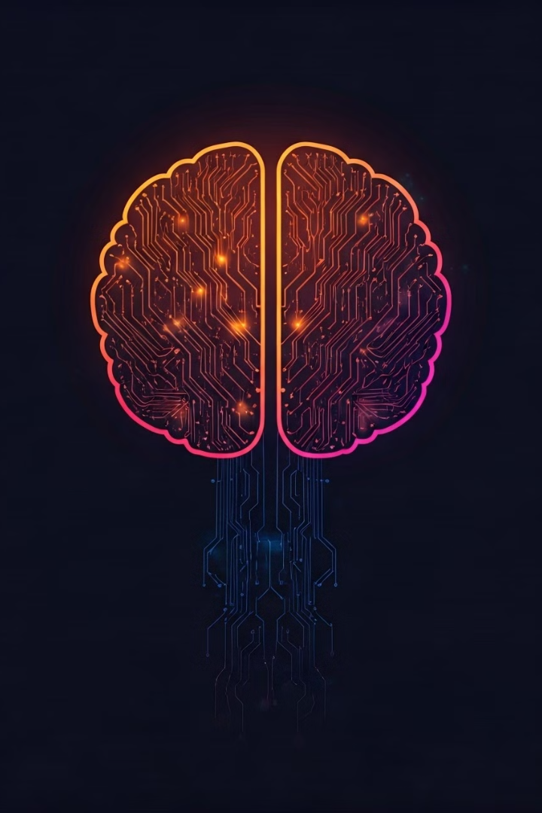
Our Approach: NLP Techniques
1
Sentiment Analysis
Detect user emotions in feedback as positive, negative, or neutral.
2
Text Classification
Categorize feedback into error types like crashes or performance bugs.
3
Named Entity Recognition
Identify date and time when user experienced also it identifies the functionality issues like login screen and payment gateway from feedback.

Slide 7




Corpus and Tools
User Feedback
Log Data
Tools
Collected from app reviews, issue reports, and social media comments.
Sample logs from public repositories like Kaggle and GitHub.
spaCy, NLTK for NLP, Python's re for parsing.

Slide 8
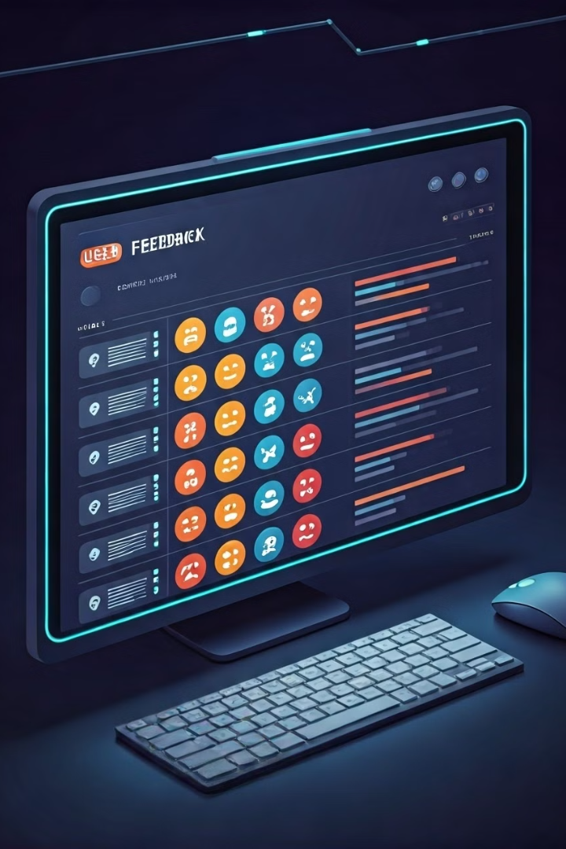
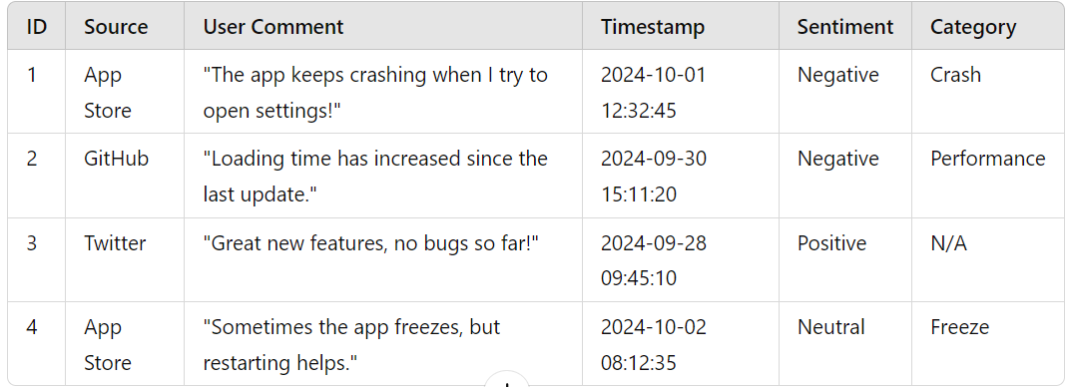
User Feedback Corpus
ID
Source
Sentiment
Category
1
App Store
Negative
Crash
2
GitHub
Negative
Performance
3
Twitter
Positive
N/A

Slide 9

Summary
This project we Further enhance the accuracy of NLP models.
It simplifies the error detection process for mobile and
web-applications by leveraging NLP techniques to analyze
user feedback and reviews. It also provides actionable insights,
allowing developers to prioritize and fix issues efficiently.

Slide 10
Thank you…!
-Just as a weather forecast prepares you for the day ahead, this project equips developers with insights to protect tackle application issues.

